Slide 1
Data Science Unit-II
Ridge & Lasso Regression

Slide 2
Introduction
Ridge Regression is a technique for analyzing multiple regression data that suffer from multicollinearity.
When multicollinearity occurs, least squares estimates are unbiased, but their variances are large so they may be far from the true value.
By adding a degree of bias to the regression estimates, ridge regression reduces the standard errors.
It is hoped that the net effect will be to give estimates that are more reliable.
Methods: 1. Principal components regression
2. Ridge regression
Ridge regression is the more popular of the two methods

Slide 3
Multicollinearity
Multicollinearity, or collinearity, is the existence of near-linear relationships among the independent variables. It is the problem in MLR.
For example, suppose that the three ingredients of a mixture are studied by including their percentages of the total. These variables will have the (perfect) linear relationship: P1 + P2 + P3 = 100. During regression calculations, this relationship causes a division by zero which in turn causes the calculations to be aborted. When the relationship is not exact, the division by zero does not occur and the calculations are not aborted.
However, the division by a very small quantity still distorts the results. Hence, one of the first steps in a regression analysis is to determine if multicollinearity is a problem.

Slide 4
Effects of Multicollinearity
Multicollinearity can create
Inaccurate estimates of the regression coefficients,
Inflate the standard errors of the regression coefficients,
Deflate the partial t-tests for the regression coefficients,
Give false, nonsignificant, p values, and degrade the predictability of the model.

Slide 5
Sources of Multicollinearity
Data collection. In this case, the data have been collected from a narrow subspace of the independent variables. The multicollinearity has been created by the sampling methodology
Physical constraints of the linear model or population. This source of multicollinearity will exist no matter what sampling technique is used. Many manufacturing or service processes have constraints on independent variables (as to their range), either physically, politically, or legally, which will create multicollinearity.
Over-defined model. Here, there are more variables than observations. This situation should be avoided.
Model choice or specification. This source of multicollinearity comes from using independent variables that are powers or interactions of an original set of variables.
Outliers. Extreme values or outliers in the X-space can cause multicollinearity as well as hide it.

Slide 6
Detection of Multicollinearity
Begin by studying pairwise scatter plots of pairs of independent variables, looking for near-perfect relationships. Also glance at the correlation matrix for high correlations. Unfortunately, multicollinearity does not always show up when considering the variables two at a time.
Consider the variance inflation factors (VIF). VIFs over 10 indicate collinear variables.
Eigenvalues of the correlation matrix of the independent variables near zero indicate multicollinearity. Instead of looking at the numerical size of the eigenvalue, use the condition number. Large condition numbers indicate multicollinearity.
Investigate the signs of the regression coefficients. Variables whose regression coefficients are opposite in sign from what you would expect may indicate multicollinearity

Slide 7
Correction for Multicollinearity
Depending on what the source of multicollinearity is, the solutions will vary.
If the multicollinearity has been created by the data collection, collect additional data over a wider X-subspace.
If the choice of the linear model has increased the multicollinearity, simplify the model by using variable selection techniques.
If an observation or two has induced the multicollinearity, remove those observations.
Above all, use care in selecting the variables at the outset.
When these steps are not possible, you might try ridge regression.

Slide 8
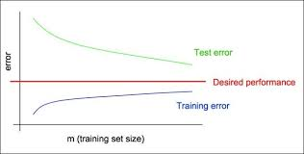
Train/Test error comparison: Learning Curves
Observe test error is more
When compare to train error of
the linear model
Here the model is doing well for training data but
Failing for test data.

Slide 9
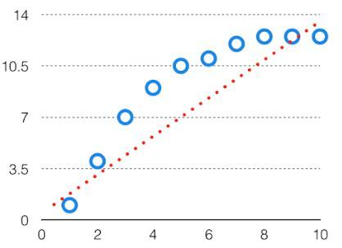
Bias
The bias is known as the difference between the prediction of the values by the ML model and the actual value.
High in biasing gives a large error in training as well as testing data. Its recommended that an algorithm should always be low biased to avoid the problem of underfitting. By high bias, the data predicted is in a straight line format, thus not fitting accurately in the data in the data set. Such fitting is known as Underfitting of Data.
This happens when the hypothesis is too simple or linear in nature. Refer to the graph given below for an example of such a situation.

Slide 10
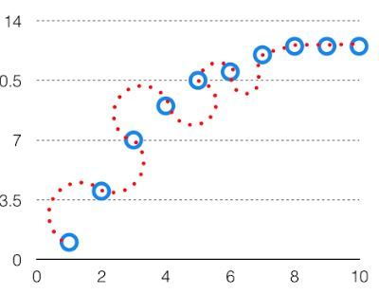
Variance
If the machine learning model performs well with the training dataset, but does not perform well with the test dataset, then variance occurs.
The model with high variance has a very complex fit to the training data and thus is not able to fit accurately on the data which it hasn’t seen before. As a result, such models perform very well on training data but has high error rates on test data.
When a model is high on variance, it is then said to as Overfitting of Data. Overfitting is fitting the training set accurately via complex curve and high order hypothesis but is not the solution as the error with unseen data ishigh. While training a data model variance should be kept low.
The high variance data looks like follows.

Slide 11
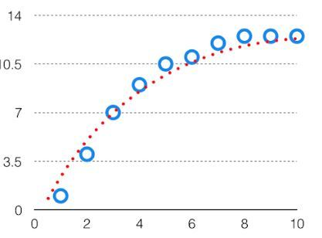
Bias Variance Tradeoff
If the algorithm is too simple (hypothesis with linear eq.) then it may be on high bias and low variance condition and thus is error-prone.
If algorithms fit too complex ( hypothesis with high degree eq.) then it may be on high variance and low bias. In the latter condition, the new entries will not perform well. Well, there is something between both of these conditions, known as Trade-off or Bias Variance Trade-off.
This tradeoff in complexity is why there is a tradeoff between bias and variance. An algorithm can’t be more complex and less complex at the same time. For the graph, the perfect tradeoff will be like. The best fit will be given by hypothesis on the tradeoff point.

Slide 12
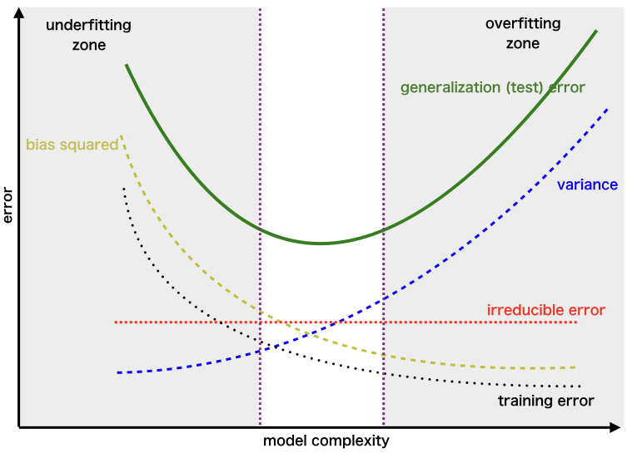
The error to complexity graph to show trade-off
Examples of low-bias machine learning algorithms include: Decision Trees, k-Nearest Neighbors and Support Vector Machines.
Examples of high-bias machine learning algorithms include: Linear Regression, Linear Discriminant Analysis and Logistic Regression.

Slide 13
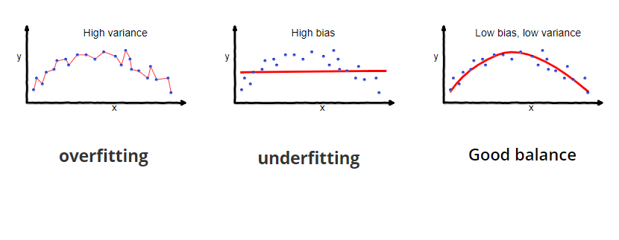
Overfitting, Underfitting and Best fitting:
Over fitting | Underfitting | Best fitting
Overfitting occurs when our machine learning model tries to cover all the data points or more than the required data points present in the given dataset. | Underfitting occurs when our machine learning model is not able to capture the underlying trend of the data. | it defines how closely the result or predicted values match the true values of the dataset.
the model starts caching noise and inaccurate values present in the dataset, and all these factors reduce the efficiency and accuracy of the model. | In the case of underfitting, the model is not able to learn enough from the training data, and hence it reduces the accuracy and produces unreliable predictions.
The overfitted model has low bias and high variance. Cross-Validation, Training with more data, Removing features Early stopping the training, Regularization, Ensembling | An underfitted model has high bias and low variance. By increasing the training time of the model. By increasing the number of features. | Low bias , low variance

Slide 14
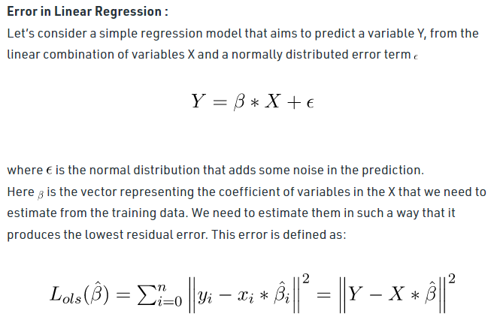

Slide 15
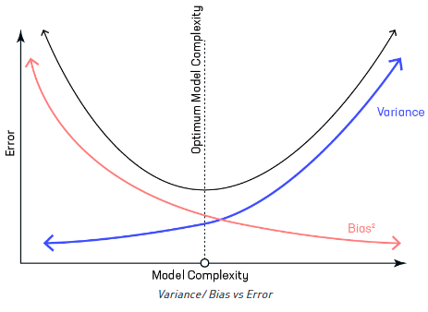
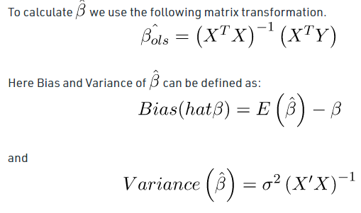
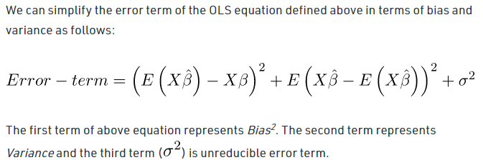

Slide 16
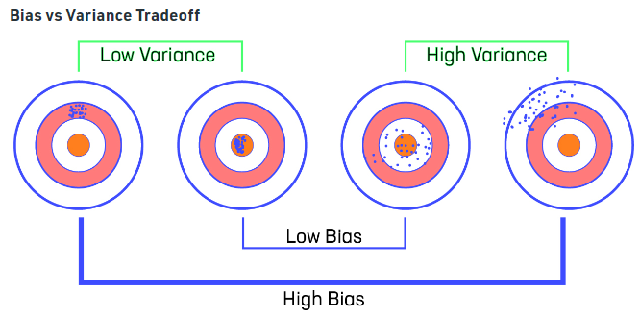
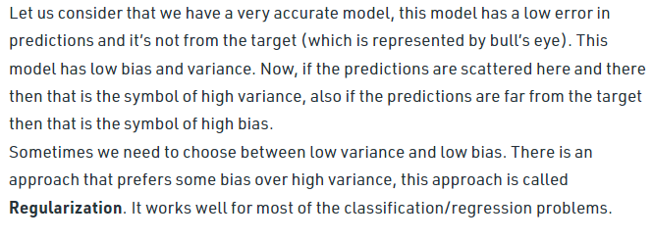

Slide 17
Regularization
Overfitting is a phenomenon that occurs when a Machine Learning model is constraint to training set and not able to perform well on test data.
Regularization is a technique used to reduce the errors by fitting the function appropriately on the given training set and avoid overfitting.
The commonly used regularization techniques are :
1. L1 regularization
2. L2 regularization
3. Dropout regularization
A regression model which uses L1 Regularization technique is called LASSO(Least Absolute Shrinkage and Selection Operator) regression.
A regression model that uses L2 regularization technique is called Ridge regression.

Slide 18
Ridge regression: Standardization
In ridge regression, the first step is to standardize the variables (both dependent and independent) by subtracting their means and dividing by their standard deviations.
All ridge regression calculations are based on standardized variables. When the final regression coefficients are displayed, they are adjusted back into their original scale. However, the ridge trace is in a standardized scale.

Slide 19
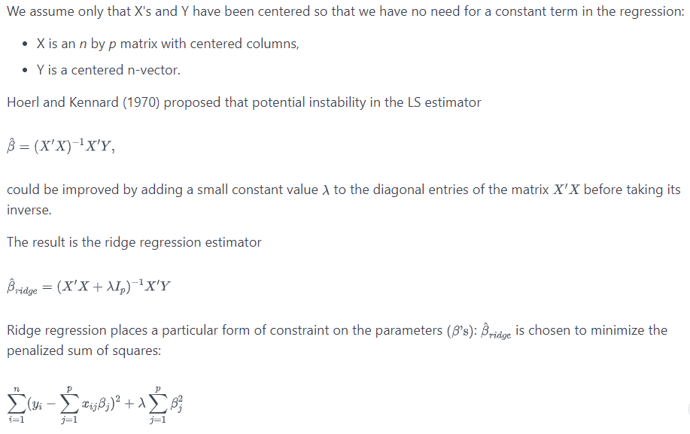
Ridge Regression Basics

Slide 20
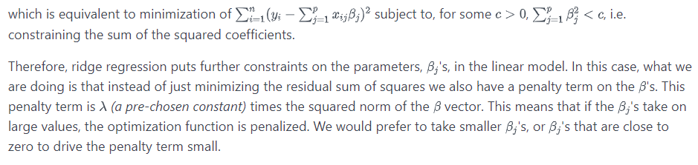
Ridge Regression Basics

Slide 21
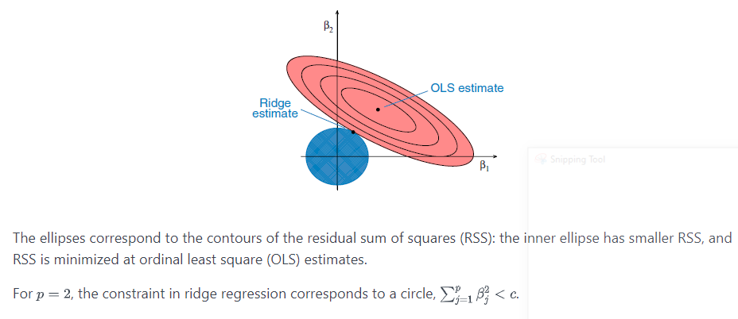
Geometric Interpretation of Ridge Regression

Slide 22
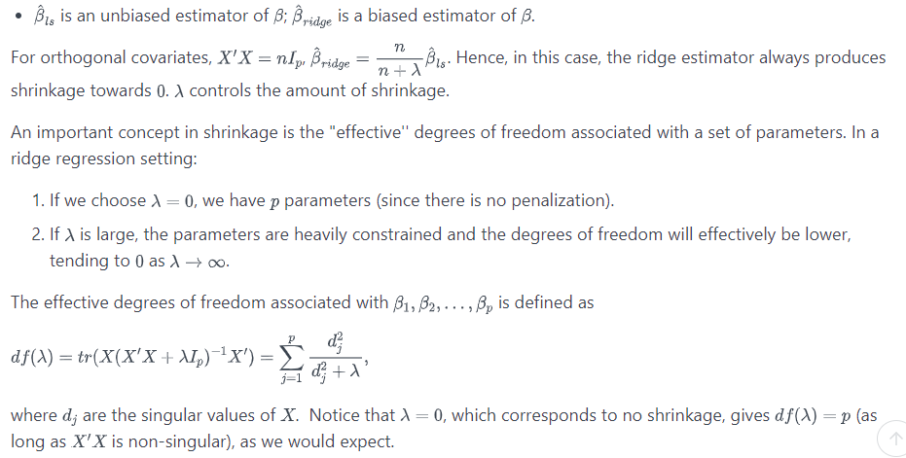
Properties of Ridge Estimator

Slide 23
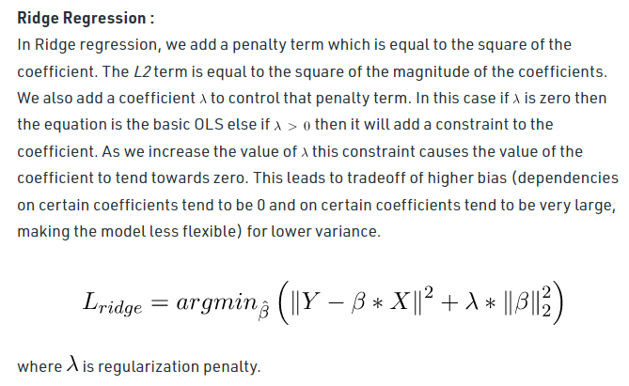

Slide 24

Limitations of Ridge regression- Lasso regression
Ridge regression decreases the complexity of a model but does not reduce the number of variables since it never leads to a coefficient been zero rather only minimizes it. Hence, this model is not good for feature reduction.
Lasso regression stands for Least Absolute Shrinkage and Selection Operator.
It adds penalty term to the cost function. This term is the absolute sum of the coefficients. As the value of coefficients increases from 0 this term penalizes, cause model, to decrease the value of coefficients in order to reduce loss.
The difference between ridge and lasso regression is that it tends to make coefficients to absolute zero as compared to Ridge which never sets the value of coefficient to absolute zero.

Slide 25
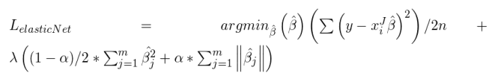
Limitations of Lasso regression- Elastic net
Lasso sometimes struggles with some types of data. If the number of predictors (p) is greater than the number of observations (n), Lasso will pick at most n predictors as non-zero, even if all predictors are relevant (or may be used in the test set).
If there are two or more highly collinear variables then LASSO regression select one of them randomly which is not good for the interpretation of data
Elastic Net :
Sometimes, the lasso regression can cause a small bias in the model where the prediction is too dependent upon a particular variable. In these cases, elastic Net is proved to better it combines the regularization of both lasso and Ridge. The advantage of that it does not easily eliminate the high collinearity coefficient

